Slide 1
# STORKS
Presented by Jimmy Cassarino

Slide 2
# STORKS
Presented by Jimmy Cassarino

Slide 3
THE
CONTEXT
CORRELATIONS AND HOSPITAL MANAGEMENT
You may have noticed hospital management is a HOT topic nowadays.
To handle more efficiently their material needs and their human resources, a large association of hospitals aims at predicting maternity occupation rates and put in place an alerting system to help decision-making.
Many factors could influence pregnancy and natality, from weather conditions to football results, through travel agencies activity. There are so many variables that could be taken into consideration, that the association decided to limit them to twitter hashtags at first.

Slide 4
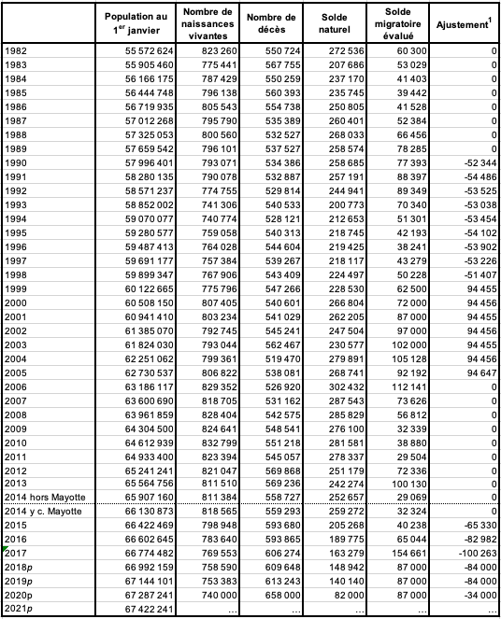
DATASET
A data set (or dataset) is a collection of data. In the case of tabular data, a data set corresponds to one or more database tables, where every column of a table represents a particular variable, and each row corresponds to a given record of the data set in question.

Slide 5
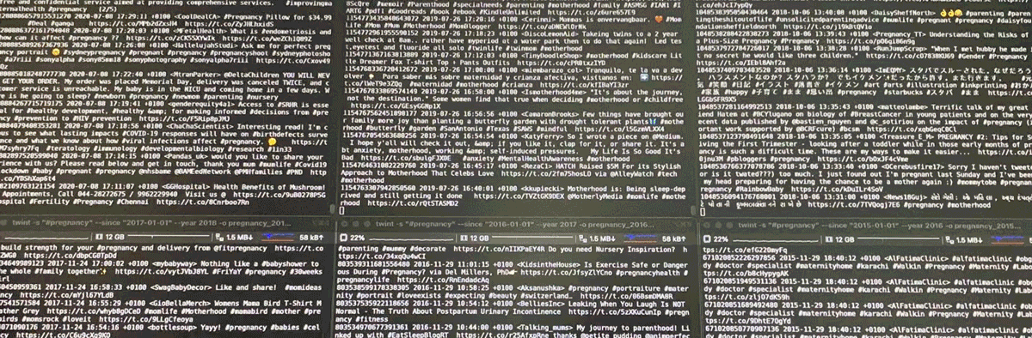
MAKE
A DATASETS
To make my datasets from the Twitter feed I had to use a scraper.
But what is a scraper ?

Slide 6

SCRAPER
Web scraping, web harvesting, or web data extraction is data scraping used for extracting data from websites. The web scraping software may directly access the World Wide Web using the Hypertext Transfer Protocol or a web browser.

Slide 7
DATA
VISUALIZATION
Data visualization is the graphical representation of information and data. By using visual elements like charts, graphs, and maps, data visualization tools provide an accessible way to see and understand trends, outliers, and patterns in data.

Slide 8
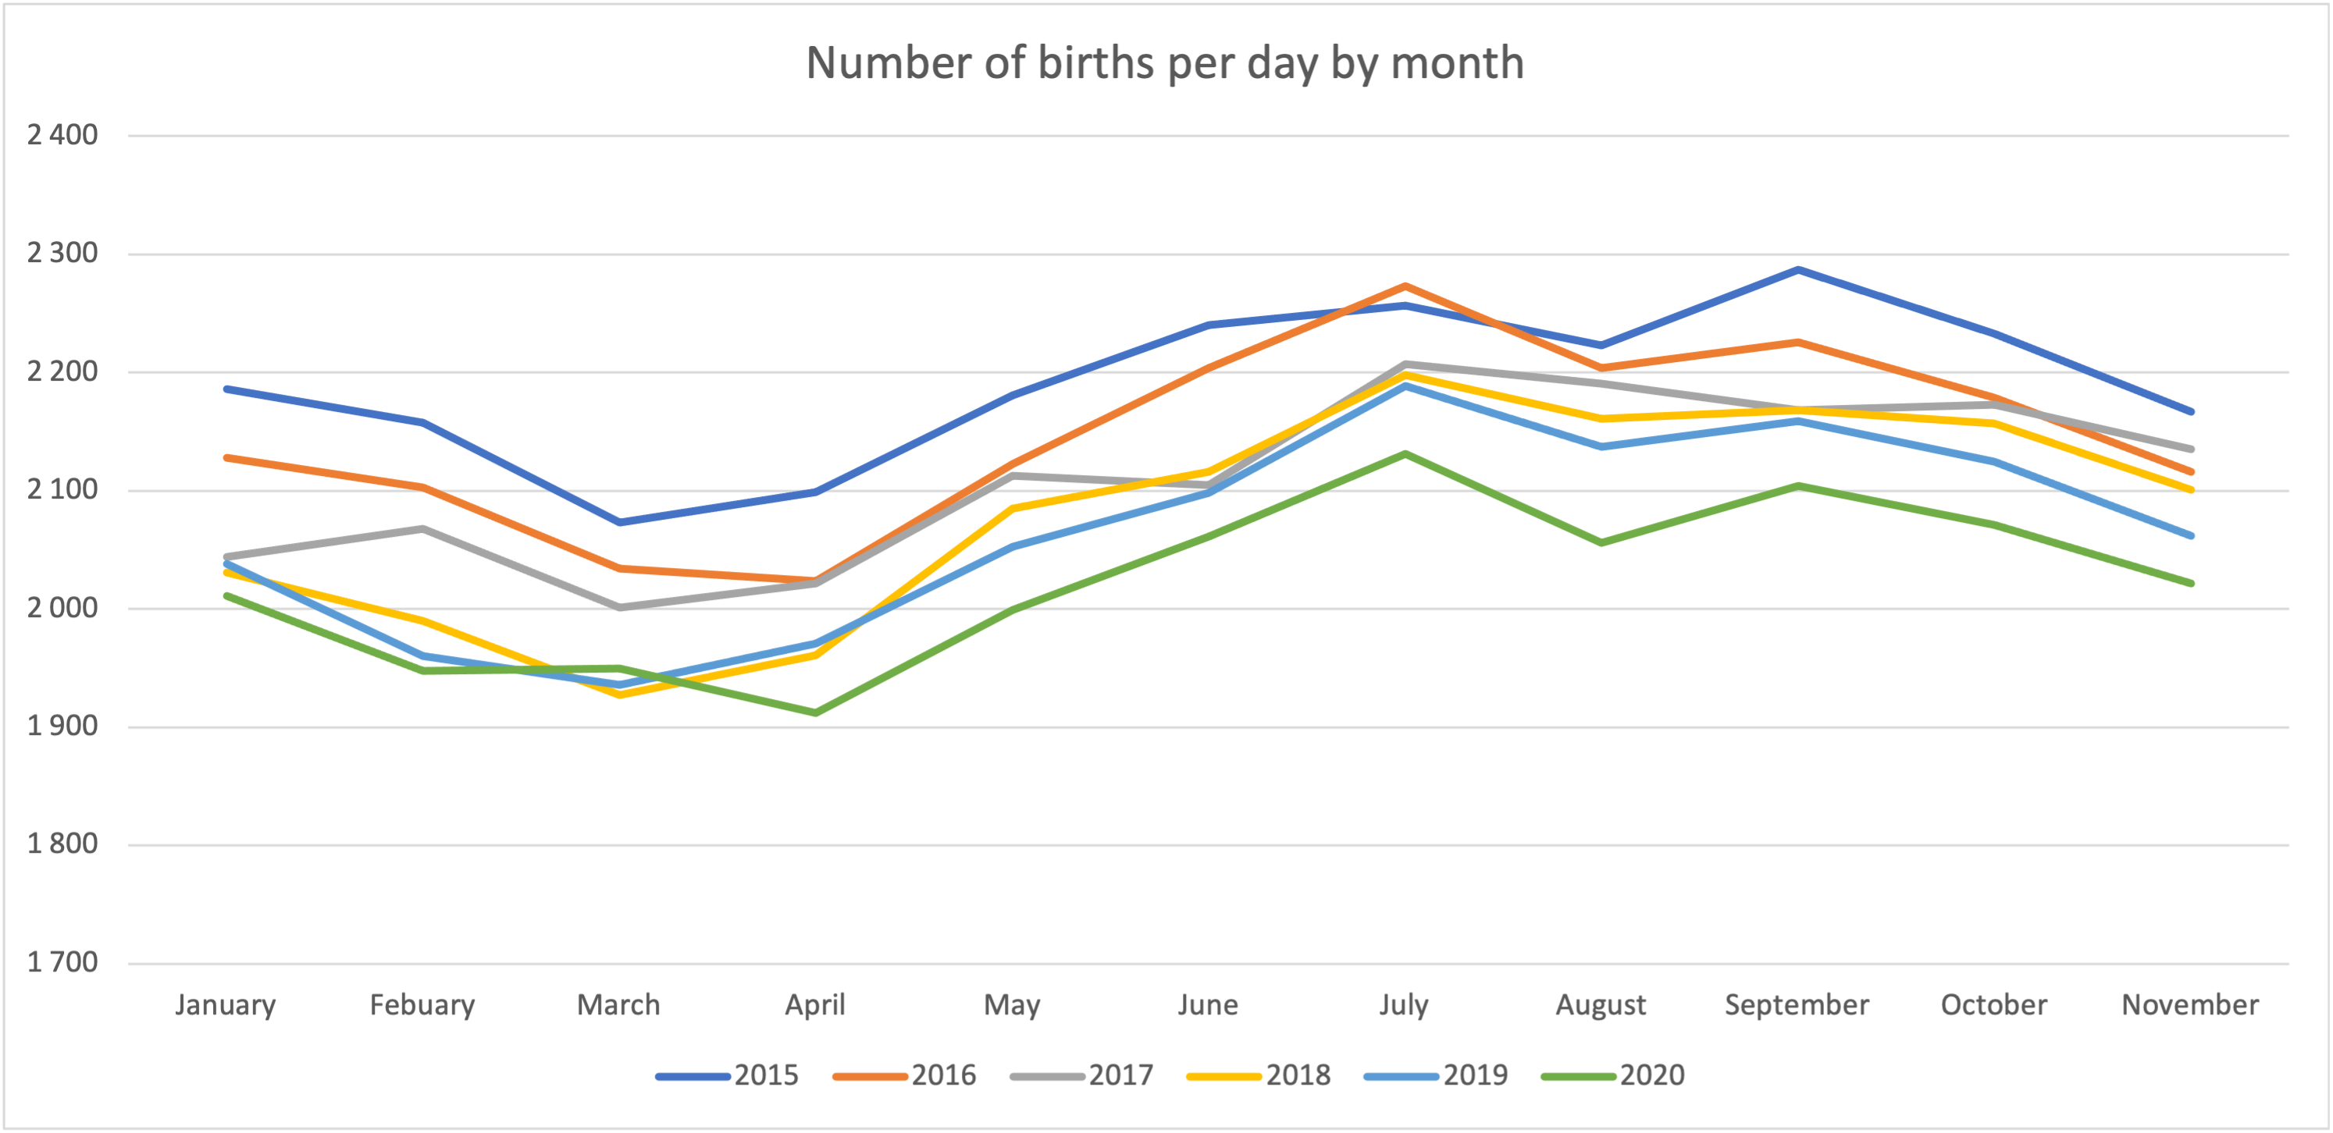
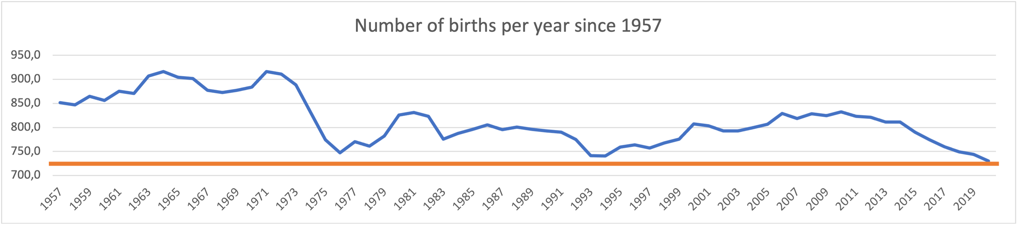
EVOLUTION OF
NUMBER OF
BIRTHS

Slide 9
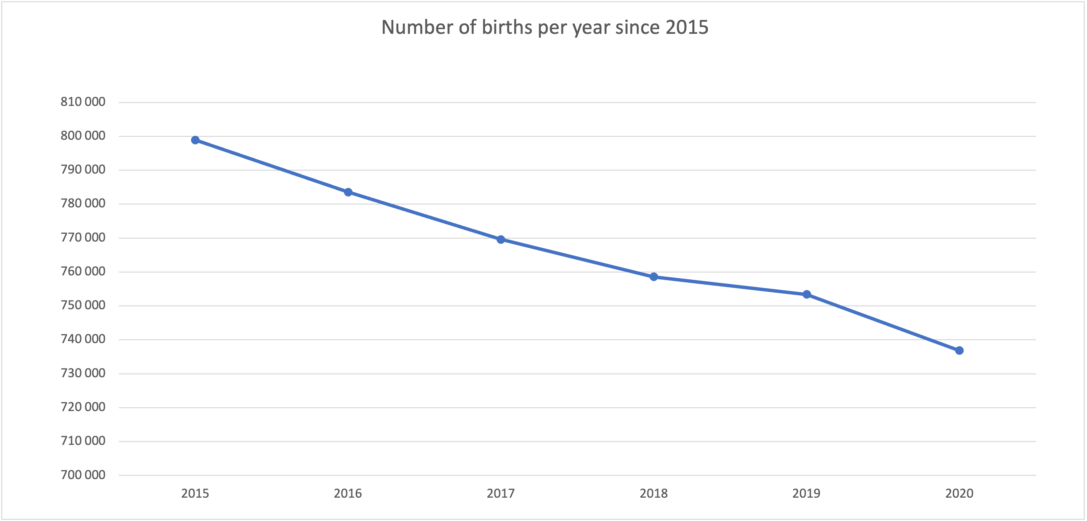
EVOLUTION OF
NUMBER OF
BIRTHS
 | Since 1957 | Since 2015 | From 2014 to 2015 | From 2015 to 2016 | From 2016 to 2017 | From 2017 to 2018 | From 2018 to 2019 | From 2019 to 2020
Taux de Diminution des naissances | -14% | -8% | -2% | -1% | -1% | -2% | -2% | -3%

Slide 10
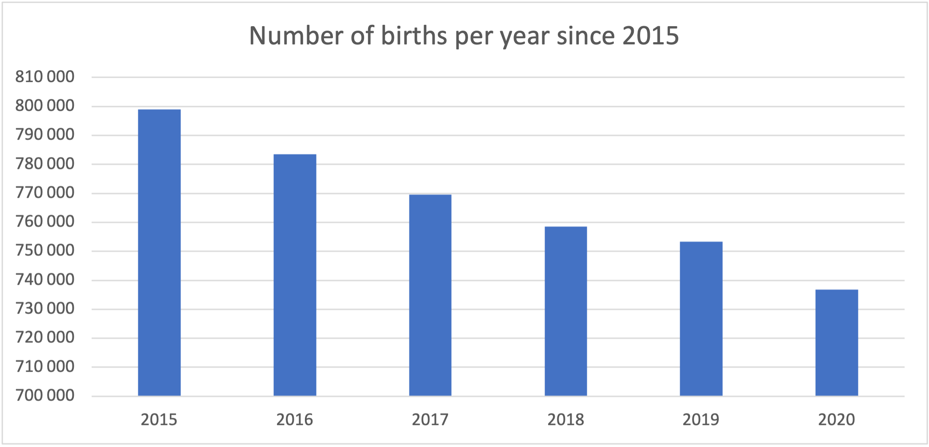
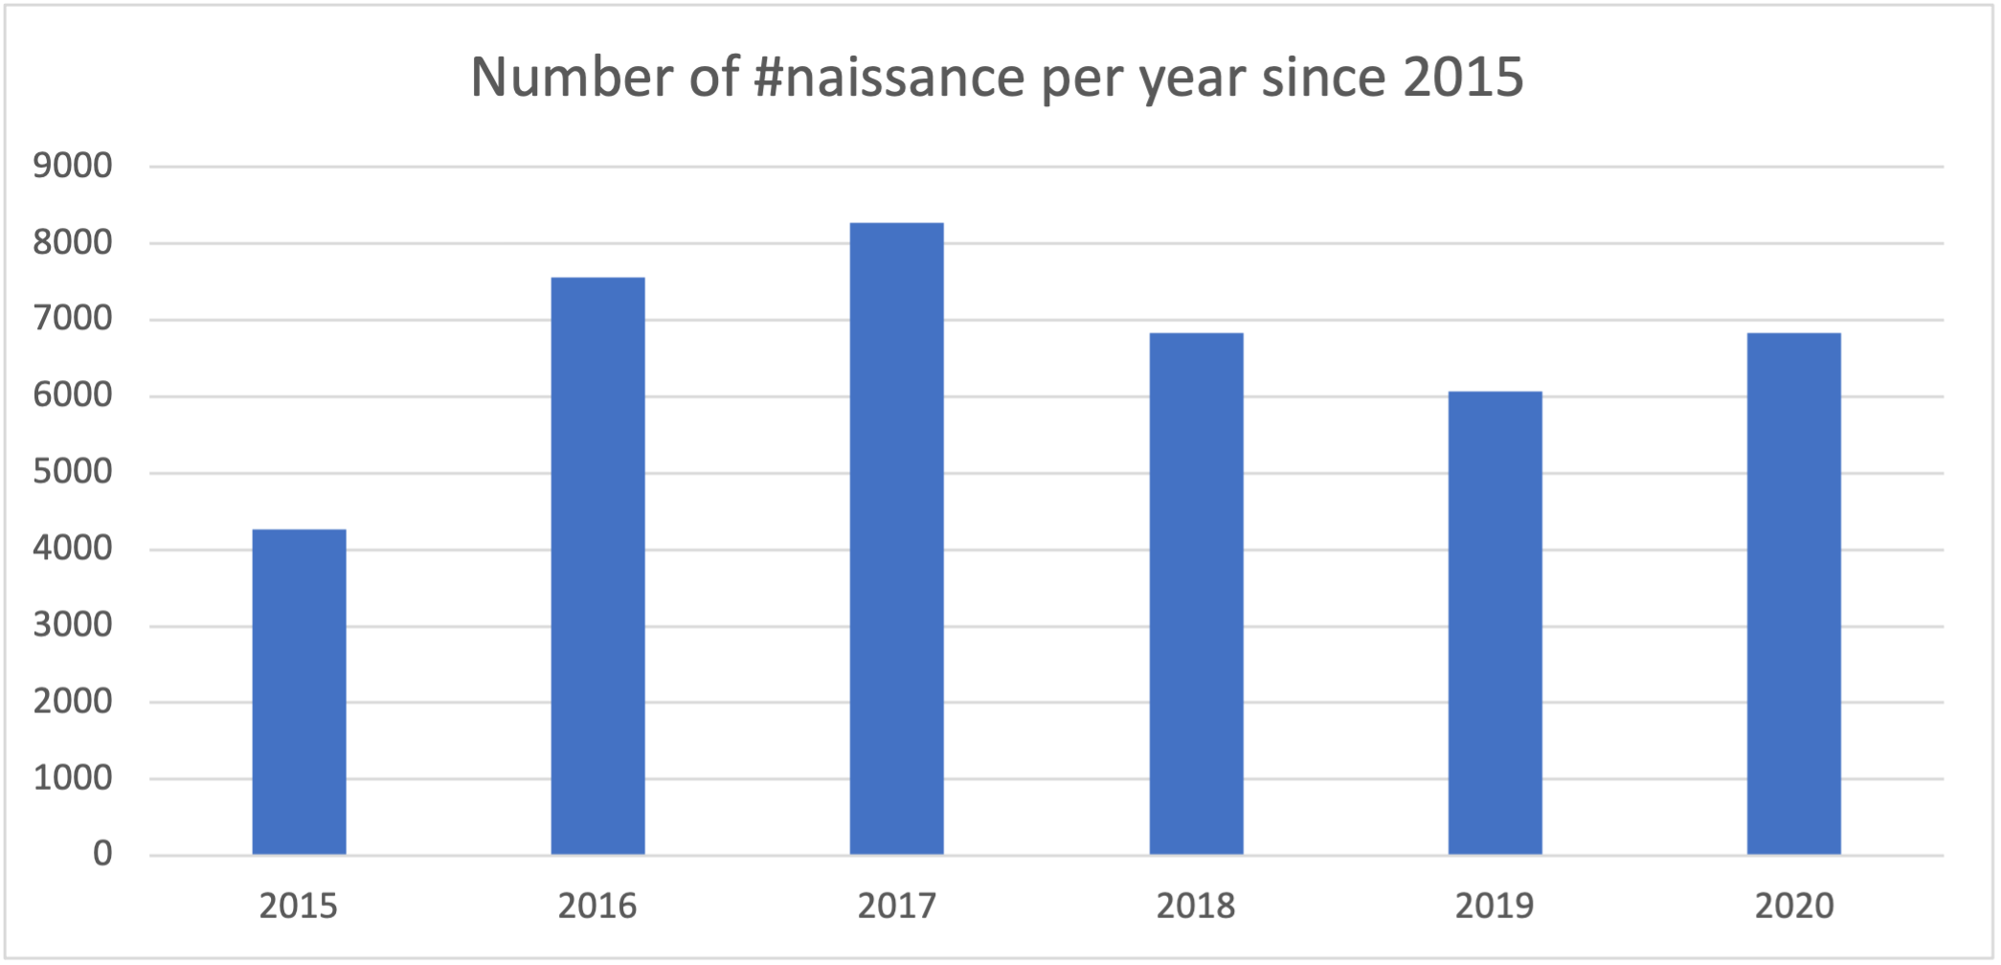
REALITY VS. TWITTER

Slide 11
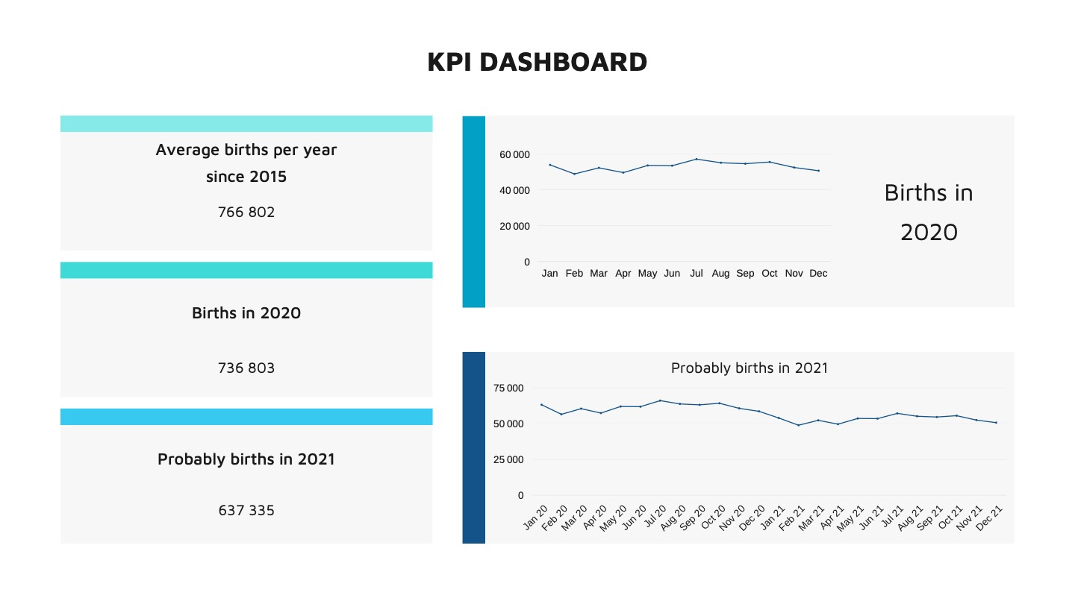

Slide 12

Bilan démographique 2020 https://www.insee.fr/fr/statistiques/5012724#figure2_radio2
Naissances et taux de natalité https://www.insee.fr/fr/statistiques/2381380#tableau-figure1
Décalage du pic de naissance https://www.insee.fr/fr/statistiques/4655279#graphique-figure1 Infos juillet 2019
https://www.lefigaro.fr/actualite-france/les-infos-qu-il-faut-retenir-du-mois-de-juillet-20190802
Bilan démographique 2016
https://www.insee.fr/fr/statistiques/2554860
SOURCES
Here are all the sources that helped me in my research to establish my case study

Slide 13
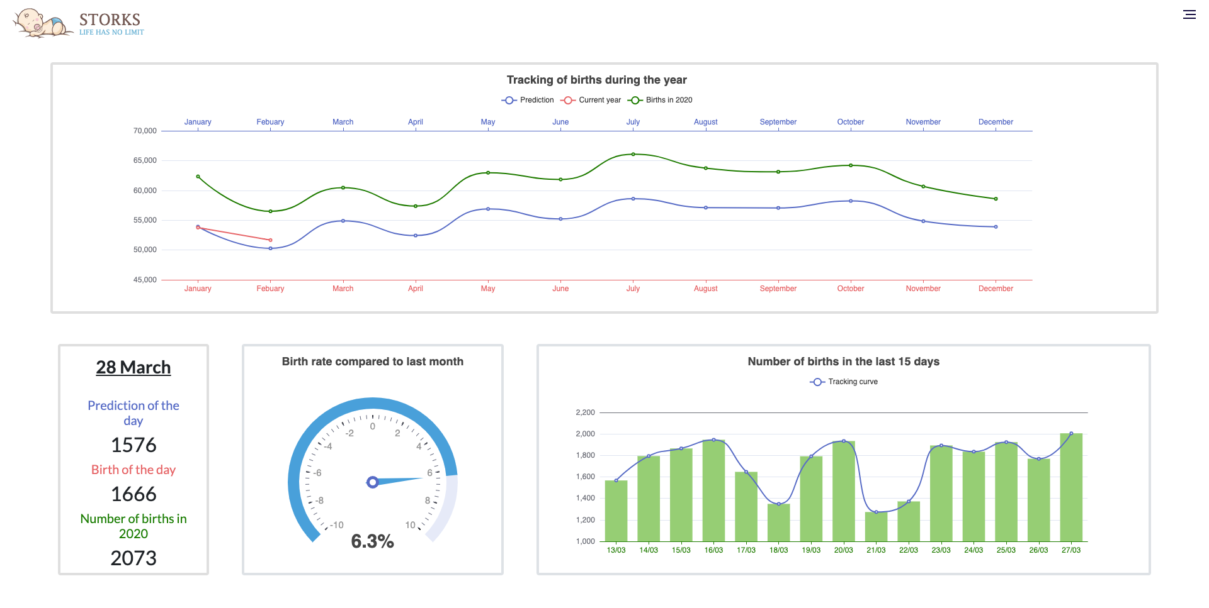
DASH-
BOARD
Here is the dashboard imagined to help maternity services during the waves of deliveries

Slide 14


DASHBOARD
DEVELOPEMENT

Slide 15
THANKS FOR
YOUR ATTENTION

